Slide 1
Pipelined Processor Demo
Bruno Peynetti, Jacob Kobza

Slide 2
Processor Overview
Top Level contains I-Memory, D-Memory and Pipeline Processor (processor must be separate for synthesis)
Pipeline Processor components fall under the following categories:
Pipeline Registers
Pipeline Stages
Register File and PC
Hazard Detection
Pipeline Processor module contains mostly wiring between stages, hazard detection and registers

Slide 3
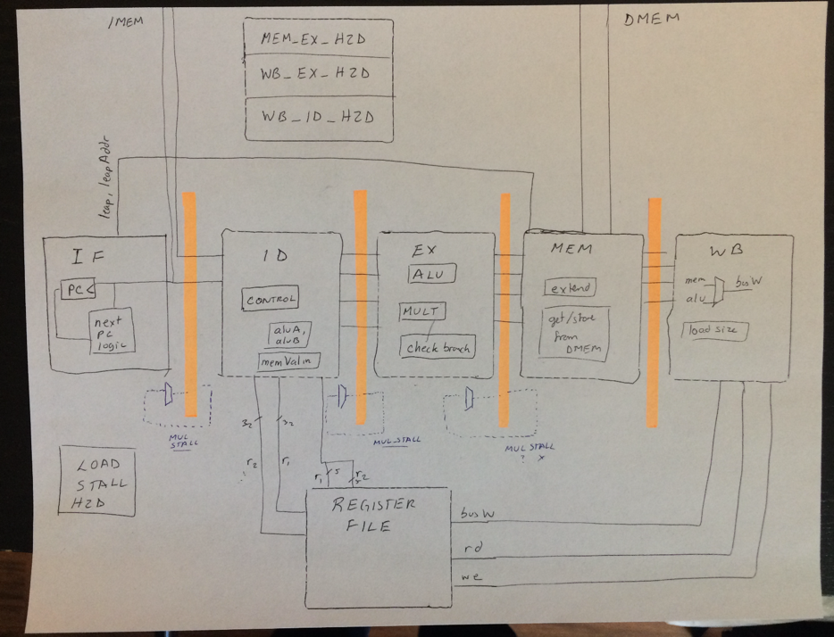
The Big Picture: Overall Pipeline Datapath

Slide 4
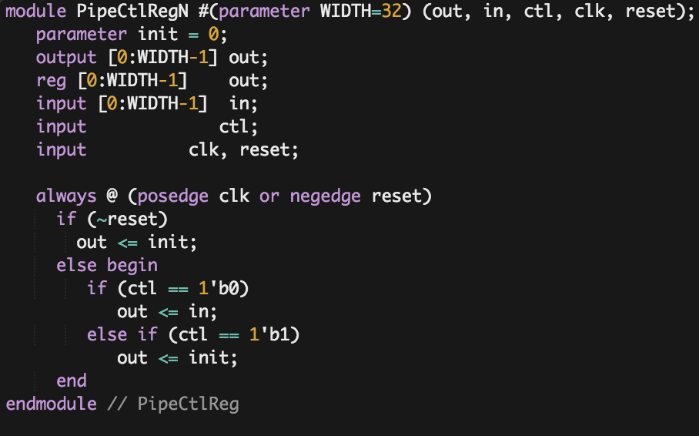
Pipeline Registers
Pipeline registers are arrays of flip flops that pass all necessary data between pipeline stages
Registers vary in size depending on what data is needed in the next stage
Input to registers includes a “flush” bit, which sets all values in the register to zero if a stall or jump/branch occurs

Slide 5
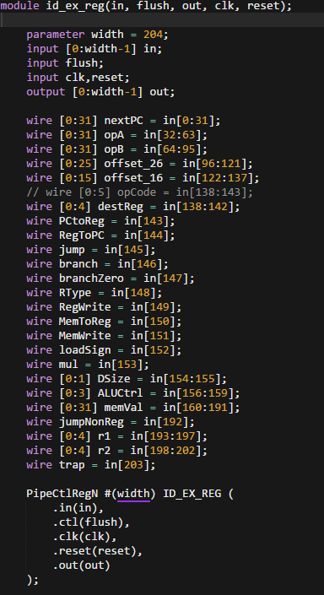
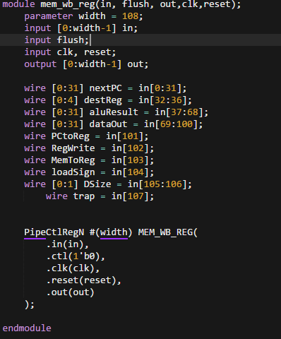
Example: ID/EX and MEM/WB Registers

Slide 6
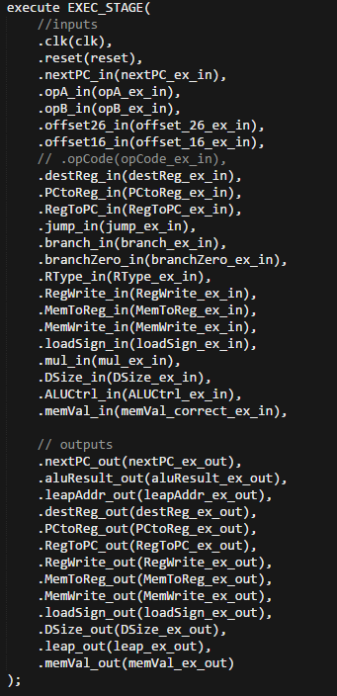
Pipeline Stages
Each pipeline stage takes the output from the register before it (not applicable for IF) and outputs the values needed for the next register (not applicable for WB)
In order to interact with I-Memory or D-Memory, stages must pass all the inputs for the memory unit up to the top level

Slide 7
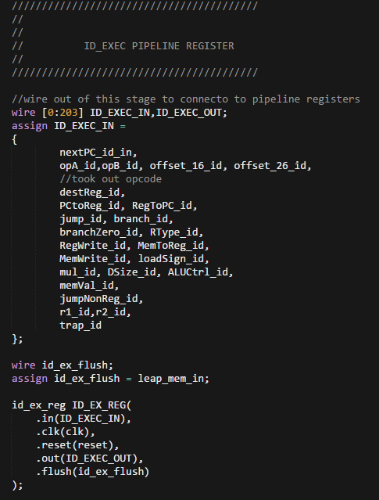
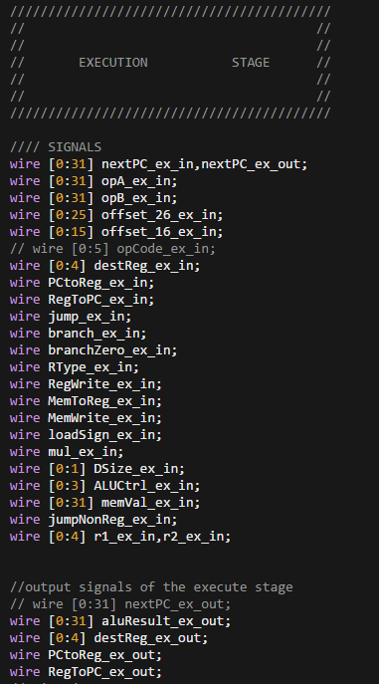
Pipeline Stage/Register Interface

Slide 8
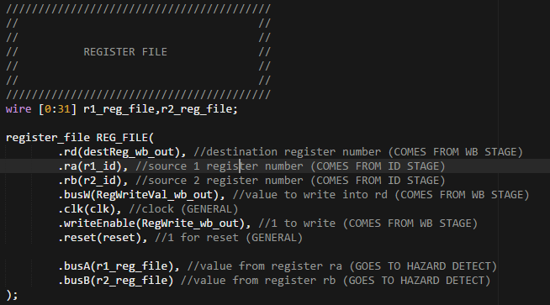
Register File
Needs to be accessed in ID and WB stages, so placed in the top level of the pipeline processor
Same design as single cycle processor

Slide 9
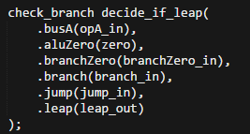
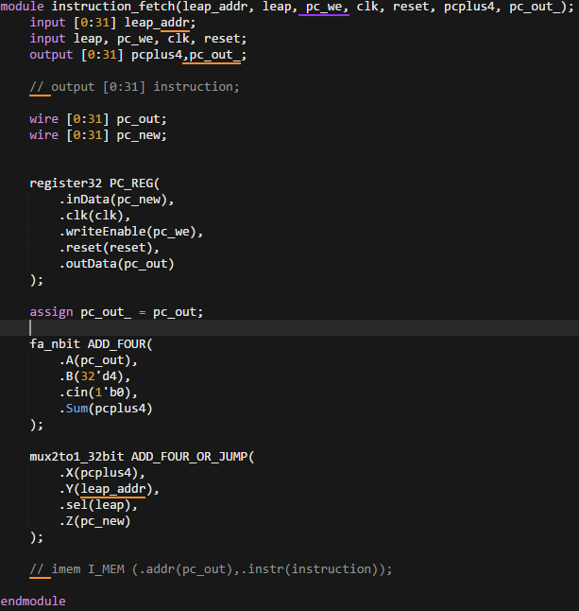
PC and PC Logic
PC implemented in IF stage, where PC is used to fetch next instruction from I-memory
“PC Logic” component from single cycle processor spread between IF and EX stages
“check_branch” component from single cycle still used to check if branch or jump occurs
Leap_out and leap_addr taken from the output of the EX/MEM pipeline register

Slide 10
Hazard Detection
We looked at each possible hazard and solved each one with one module
Then consolidated hazard detection into fewer modules (after a lot of debugging)
MEM_EX_HAZARD
WB_EX_HAZARD
WB_MEM_HAZARD -> later deleted
STALL_LOAD_HAZARD
WB_ID_HAZARD

Slide 11
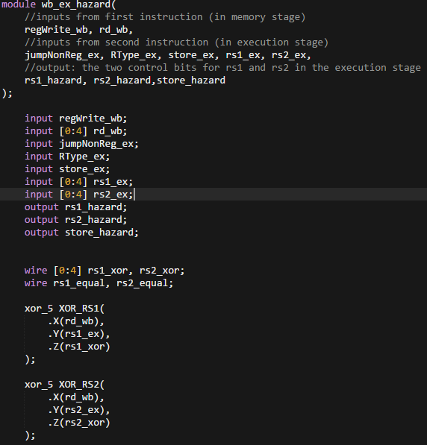
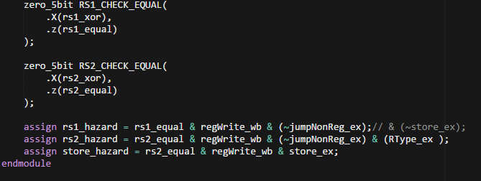
Example: WB/EX Hazard Detection

Slide 12
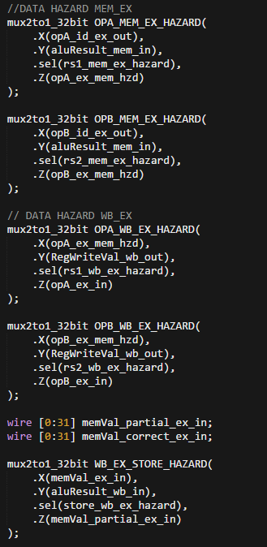
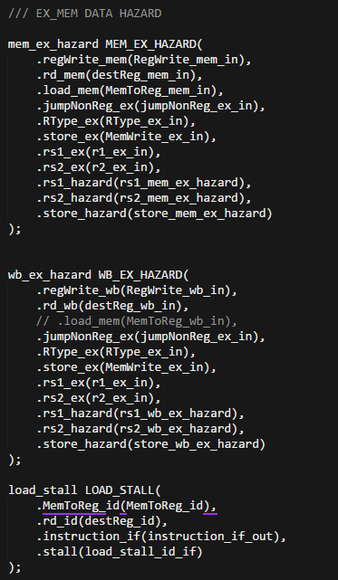
Top Level Hazard Detection Interface

Slide 13
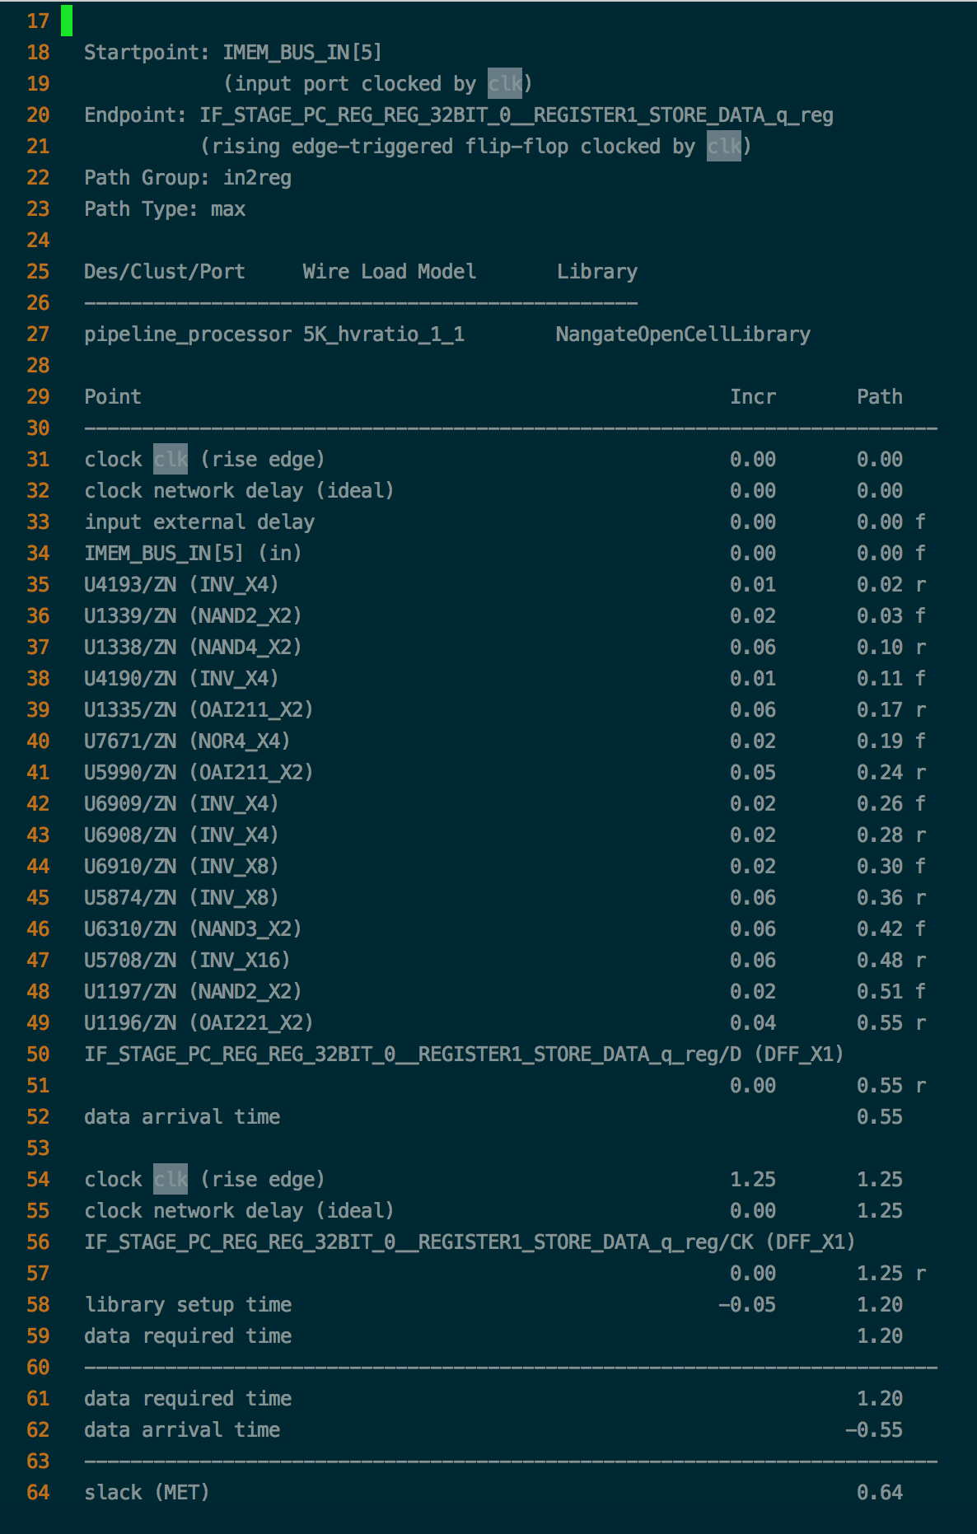
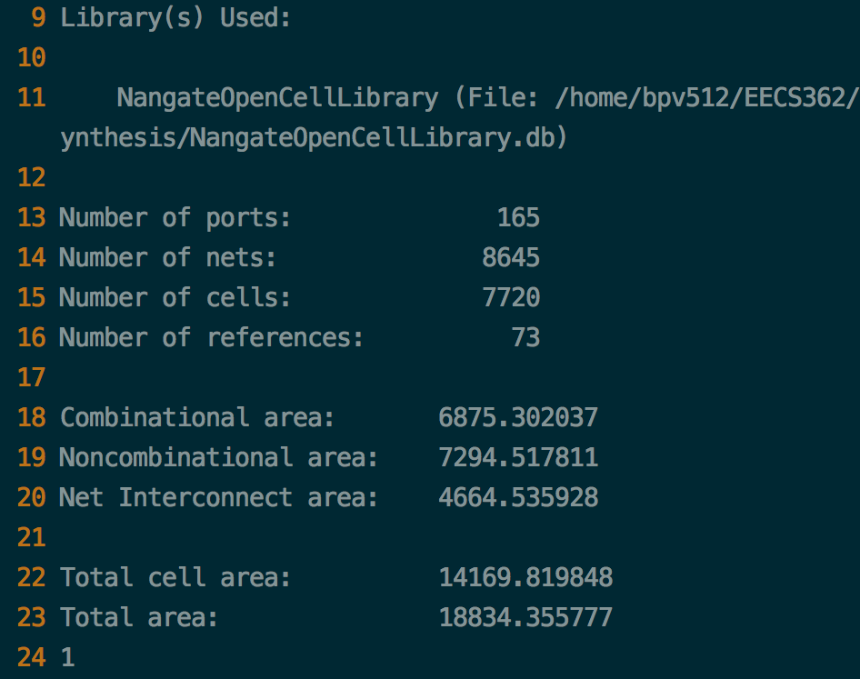
Synthesis Results
Area : 18000 um²
Timing : (800 MHz) -> MET

Slide 14
Issues While Building
Attempted to keep modularity
Caused many unnecessary signals that were later removed by synthesis
PC Logic
When stalling, we block the write enable
Jump/Branch
Flush registers and modify nextPC
Determine what to flush, what to stall
Trap detection
Executed in MEM stage to avoid unwanted writes to memory and/or registers

Slide 15
FIBONACCI DEMO: WHAT YOU’VE ALL BEEN WAITING FOR

